Slide 1

ASOS ASAP

Slide 2
Save yourself from a fashion crisis with ASOS ASAP
Forgotten an anniversary?
Ruined your best interview tie?
ASOS ASAP brings you the best products from your local Marketplace sellers, delivered within hours, not days.

Slide 3
ASOS ASAP builds on top of the OnTheDot delivery service to find the Marketplace boutique sellers within your area, ready to fulfill your fashion needs.
Built to fix time-sensitive fashion failings, products are sorted by readiness-of-delivery so you can salvage your style problems sooner.

Slide 4
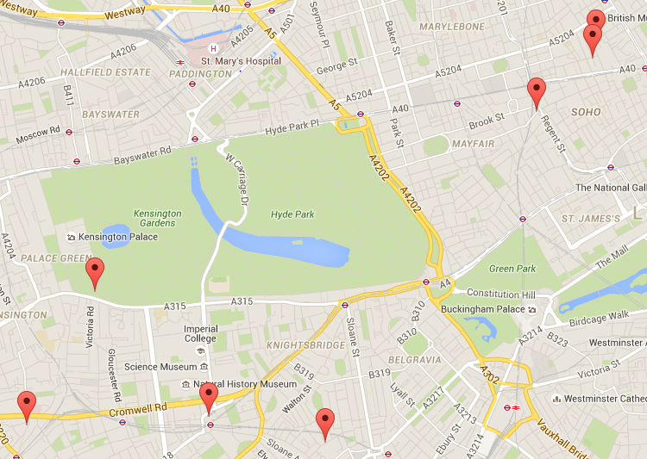




ASOS Marketplace lists products from hundreds of independent retailers across the country.
Making use of their locality, ASOS ASAP can deliver on the day when the ASOS main warehouse can't.

Slide 5
Demo

Slide 6
Future development
Geolocation for immediate local store lookup
Notifications if you stray away from your designated delivery area through geofencing-based alerts
Calendar location cross-checking, to deliver your parcel at the earliest convenience
Independent Marketplace stores could receive stock of the main ASOS website's most popular items, so that these are available locally to be delivered within hours

